Slide 1
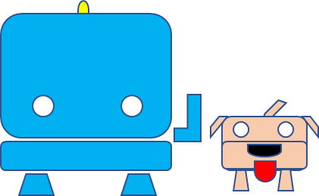
Doggy, the TJBot’s companion
When AI meets pets

Slide 2
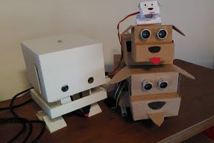
Learning Objectives
Hint: Remove this slide from student presentation
This activity complement “What’s Possible With AI – TJ Bot” Activity Kit expanding students’ knowledge regarding robotics , cognitive technologies and AI by helping them build a simple companion for TJBot, a cute dog called Doggy. Students will increase experience and skill using a Raspberry Pi, Servo Motors, Sonar sensor and unleash their creativity following TJBot and Doggy in funny tales powered by Watson™ services.
Audience:
Ages 11-14 (Middle grade students)
Ages 14-19 (Secondary/high school students)
What’s the goal of this kit?
Introduce cognitive technologies and programming
Explore “embedded cognition”— everyday objects that use AI to interact with us
Support environmental education activity reusing cardboard and common material
Why is this topic important?
The technologies introduced through this activity have a growing impact in our world.
A fun, creative, hands-on project is an ideal way to stimulate students’ interest in STEM topics

Slide 3
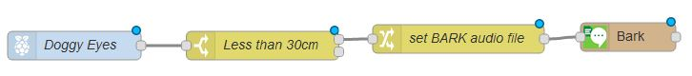
Activity Kit structure and generic requirements
Hint: Remove this slide from student presentation
This activity is composed by tales and scenes, with clear requirements and detailed steps.
Common requirements:
TJBot already setup and tested with Node-Red nodes by JeanCarl Bisson
Doggy already setup and tested (note: some scenes require a specific Doggy version. Build your Doggy according to the story that you want to tell). This activity also includes instructions to build Doggy.
Skill: Node-Red (basic level)
Age: 8+ (Doggy already setup and tested)
Age: 12+ (Doggy not yet built and setup)
Before starting, verify if updates, including more tales, are available on Doggy Web Site

Slide 4
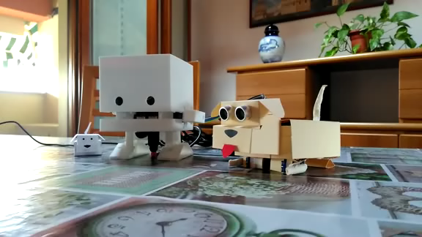
What are we going to do today?
TJBot loves pets even though they can be noisy. He/Her owns two dogs, Doggy and MiniDoggy.
Doggy is a very careful watchdog while MiniDoggy is more distracted one, it doesn’t look at what happens around it but it’s happy to play with TJBot.
We follow TJBot and its doggies in some funny stories learning how IBM solutions could be applied to real life examples.
Doggy is an original idea from IBM Italy Volunteers. The first draft version was developed during a stage with high school students in IBM Italy Segrate, May 2018.

Slide 5
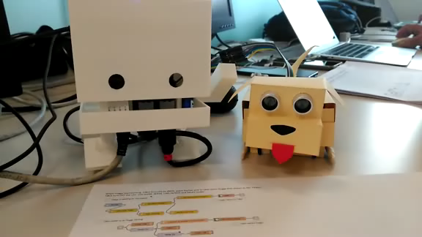
Detailed Agenda (click & go)
Create and setup your own Doggy (Doggy Basic, Doggy Standard, Doggy Premium, MiniDoggy)
Tale 1 - Nothing and no one can pass without getting a strong barking from Doggy. TJBot calms it, getting a cute tail wagging from Doggy.
Tale1.Scene1 - Create a flow that makes Doggy say “BARK!” if an object is less than 30cm away
Tale1.Scene2 – Make Doggy barking (a real barking!) if an object is less than 30cm away
Tale1.Scene3 – Smart barking, just one time, please!
Tale1.Scene4 – Doggy is happy and wags its tail!
Tale1.Scene5 - TJBot wakes up when Doggy start barking and calms it recognizing the object
Tale 2 – Doggy likes his treats. It needs to eat healthier and start doing exercises
Tale2.Scene1 - Stand Up, Doggy - Doggy stands up on its front legs when anything is less that 30cm away
Tale2.Scene2 – Doggy, trying to do push-ups - Doggy does push-ups when anything is less that 30cm away
Tale2.Scene3 – TJBot helps Doggy doing exercises - When anything is less that 30cm away, TJBot start counting push-ups for Doggy

Slide 6
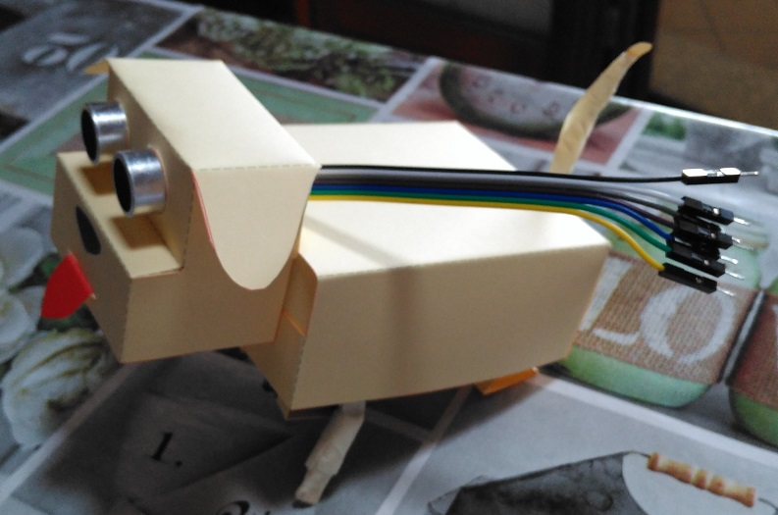
Instruction: Create and setup your own Doggy
Doggy's family:
DOGGY BASIC - Doggy hosts an HC-SR04 sensor that provides a superdog vision.
DOGGY STANDARD - In addition to BASIC format, Doggy has also a very cute tail, powered by one SG-90 servo motor.
DOGGY ADVANCED (PREMIUM) - Doggy increases its capability with two motorized front legs powered by 2 x SG-90 servo motors.
MINIDOGGY - This little Doggy has just a tail moved by one SG-90 servo motor. Little and very friendly!
Doggy is very easy to build because it’s provided with A4 format design file (DXF/PDF). Just print/copy it and cut, fold, connect!
Before let Doggy runs through digital fields, we have to test its features and tune up some little things. Apply the following setup instructions to your Doggy version:
Setup and Test Doggy superdog vision (HC-SR04)
Setup and Test Doggy tail (SG-90)
Setup and Test Doggy front legs (SG-90)
Level: some tasks could be tricky but could be performed under adult’s guidance
Agenda

Slide 7
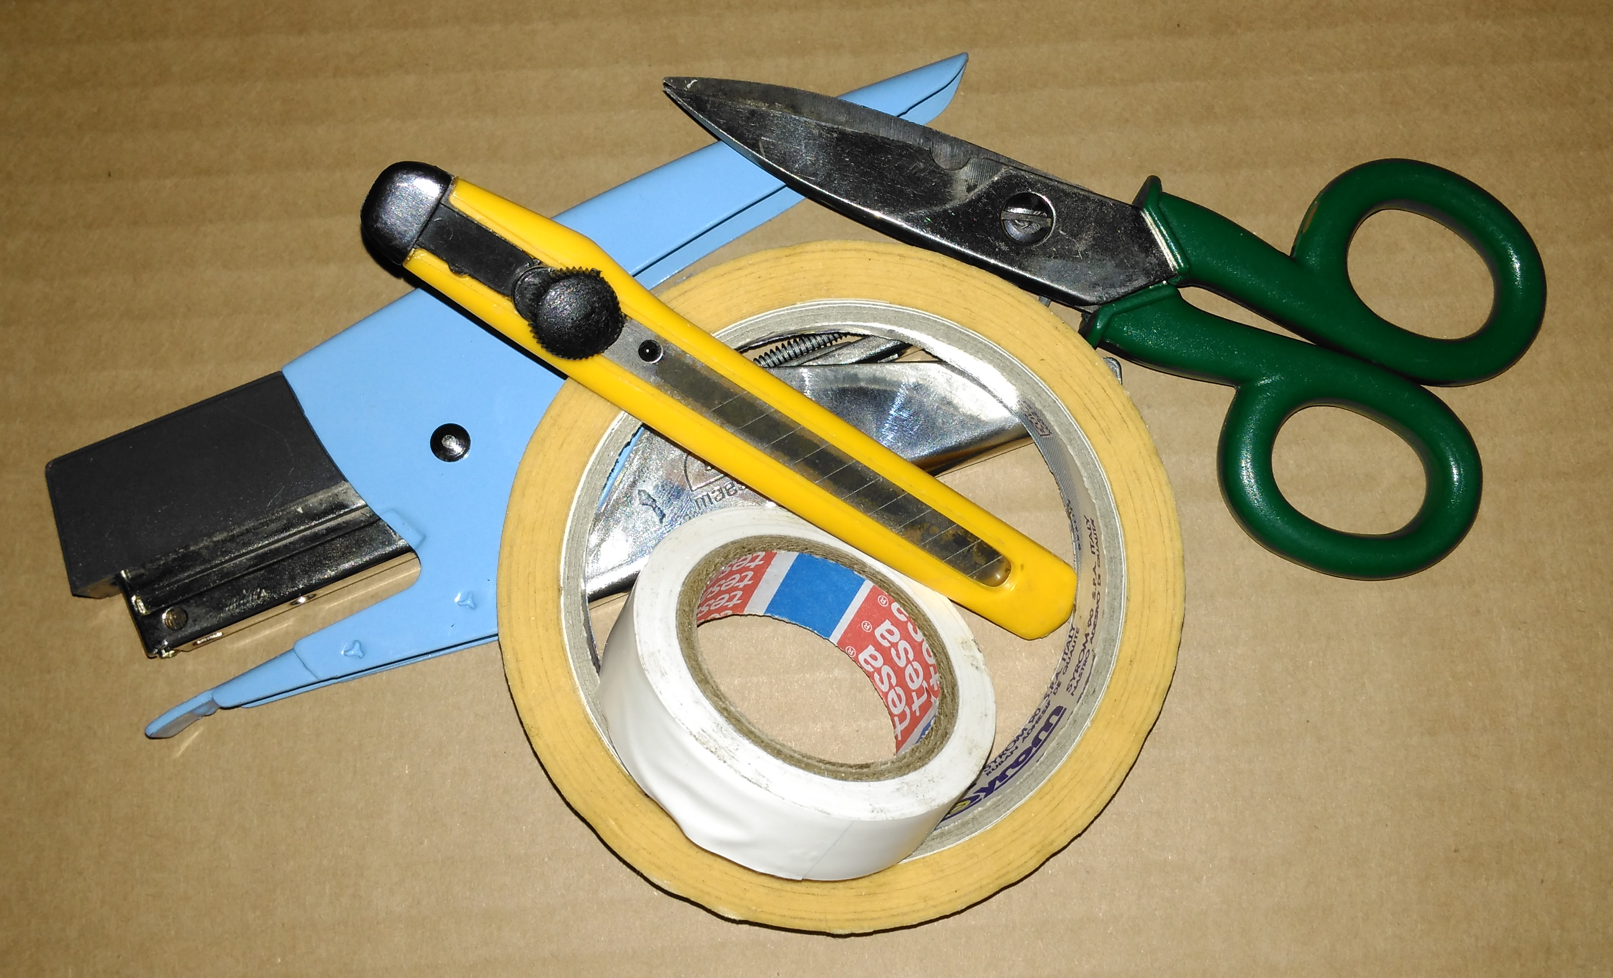
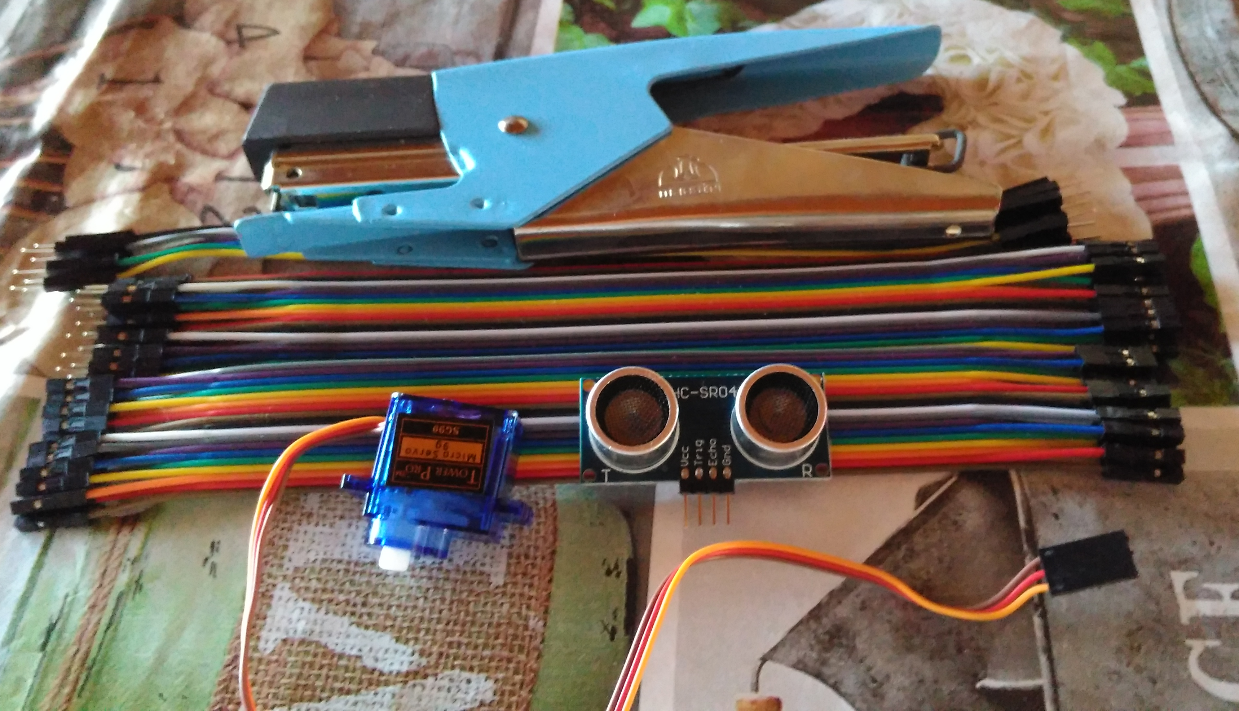
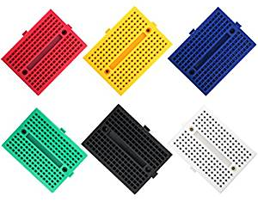
HW requirement
Instruction: Create your own Doggy – 2
Component | Doggy Basic | Doggy Standard | Doggy Advanced (Premium) | MiniDoggy
TJBot setup with JCBisson Node-Red nodes | Yes | Yes | Yes | Yes
1 x HC-SR04 ultrasonic sensor for TJDog supervision | Yes | Yes | Yes | No
1 x SG90 servo motor for TJDog tail | No | Yes | Yes | Yes
2 x SG90 servo motor for TJDog front legs | No | No | Yes | No
1 x Breadboard | No | Optional | Yes | No
Cables, Cardboard, stapler, marking pens, scotch tape | Yes | Yes | Yes | Yes
Agenda
Level: some tasks could be tricky but could be performed under adult’s guidance

Slide 8
Download and Print/Copy Design files
Instruction: Create your own Doggy – 3
Get the last design file from Doggy Github house
Doggy Basic - Superdog vision only (Doggy DXF format, Doggy PDF format - basic parts)
Doggy Standard - Basic plus ultra-dynamic tail (Doggy DXF format, Doggy PDF format - basic parts
Doggy Premium - Standard plus powerful front legs (Doggy DXF format, Doggy PDF format - basic parts, Doggy PDF format - Optional and advanced parts)
MiniDoggy - ultra-dynamic tail only (MiniDoggy DXF format, MiniDoggy PDF format)
Print or Copy the design file on selected support
Doggy Basic - Do not use common printer paper. Doggy Basic can be easily printed on 200gr/m² A4 paper (local print shop or standard printer) or cardboard. 200gr/m² A4 paper is enough strong to support sensor weight. No need for "Belly" part (but if you like it, just fold and insert it).
Doggy Standard – As Basic, "Belly" part is optional, depending upon wiring choices (but if you like it, just fold and insert it).
Doggy Premium – As Basic, except that "Belly" part is mandatory. It could be printed on 200gr/m² A4 paper, but cardboard is the best choice.
MiniDoggy - MiniDoggy can be easily printed on 200gr/m² A4 paper (local print shop or standard printer) 200gr/m² A4 paper is enough strong to support servo motor weight. No need for "Belly" part (but if you like it, just fold it and insert mounting servo on it). Belly part is mandatory if you use standard printer paper.
HINT: The best way to learn how to build Doggy is to print it on common A4 paper and build a prototype.
Please, share your experience on Doggy's House!!!
Agenda
Level: some tasks could be tricky but could be performed under adult’s guidance

Slide 9
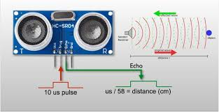
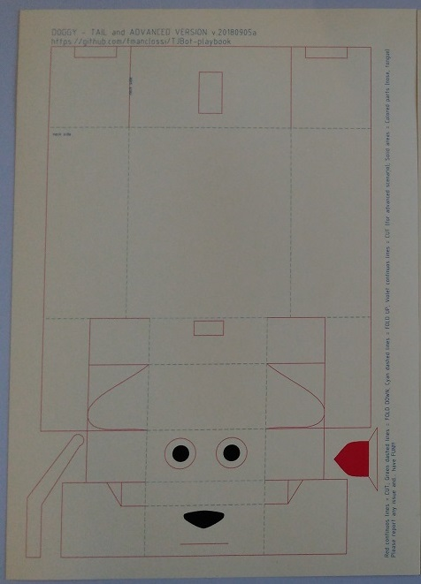
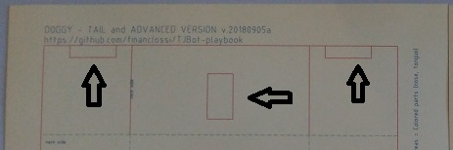
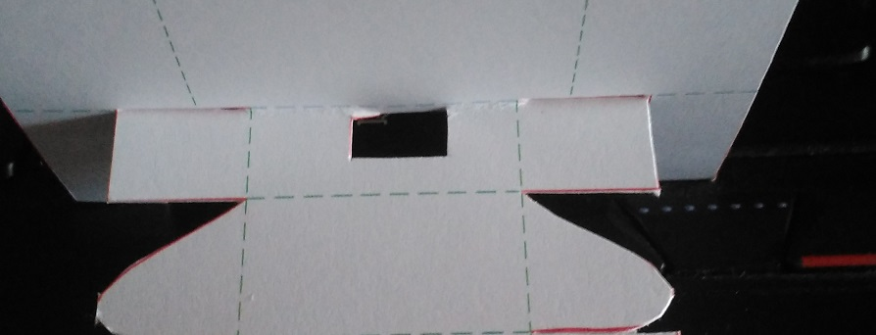
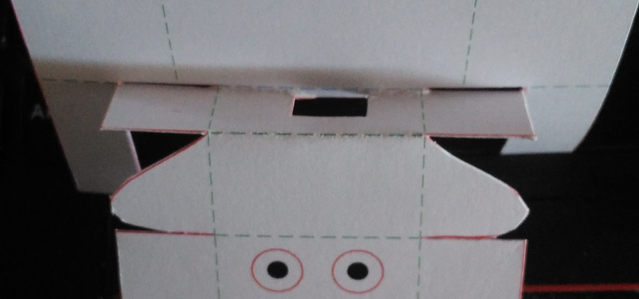
Mount Doggy Basic - a TJBot companion with superdog vision!
Instruction: Create your own Doggy – 4a
Get and Print/Copy DOGGY BASIC design file - Print/reproduce only the Tail and advanced Sheet
Cut all the red lines using a cutter and a scissor (do not cut parts to host servo motor for tail). If you plan to use superdog vision, remind to cut eyes too. (P.S: in the following pictures these lines are cut as used in Standard and Advanced version)
fold up or down cyan and green lines
fold up
fold down
Agenda

Slide 10
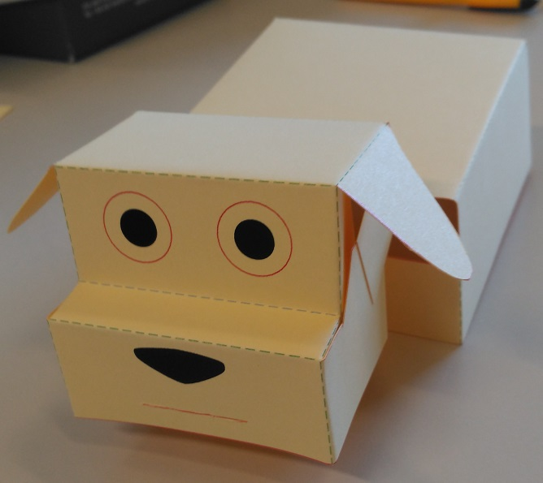
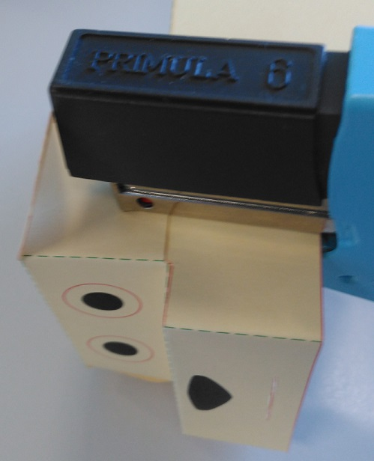
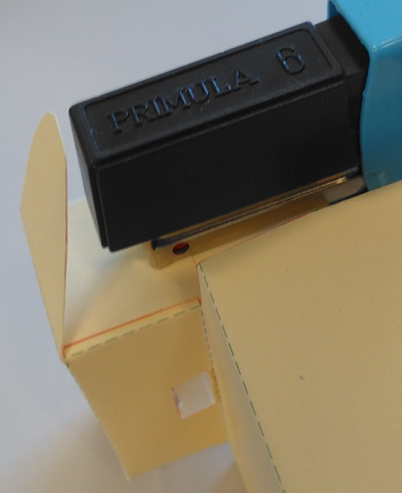
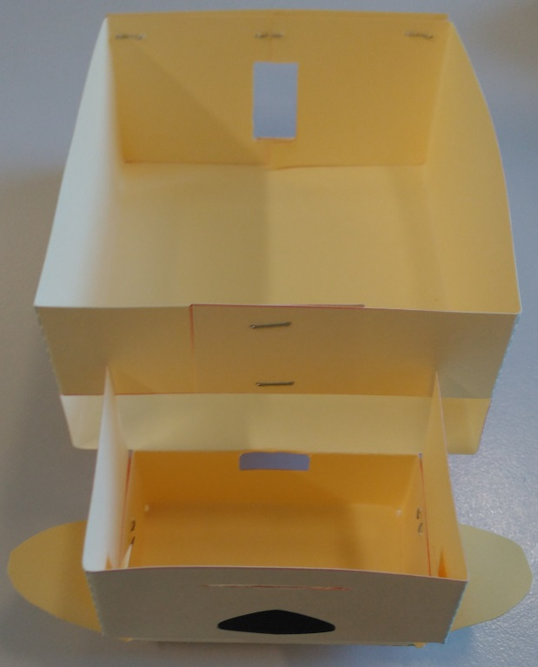
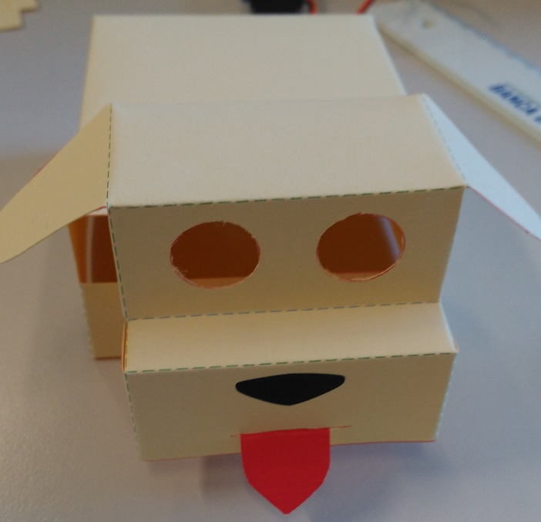
Mount Doggy Basic - a TJBot companion with superdog vision!
Instruction: Create your own Doggy – 4b
Doggy is folded up & down (and I forget to cut eyes ☹ )
staple left and right ears
staple neck and back (this phot is from the Standard - Premium Doggy)
insert tongue and clip the tail
Agenda

Slide 11
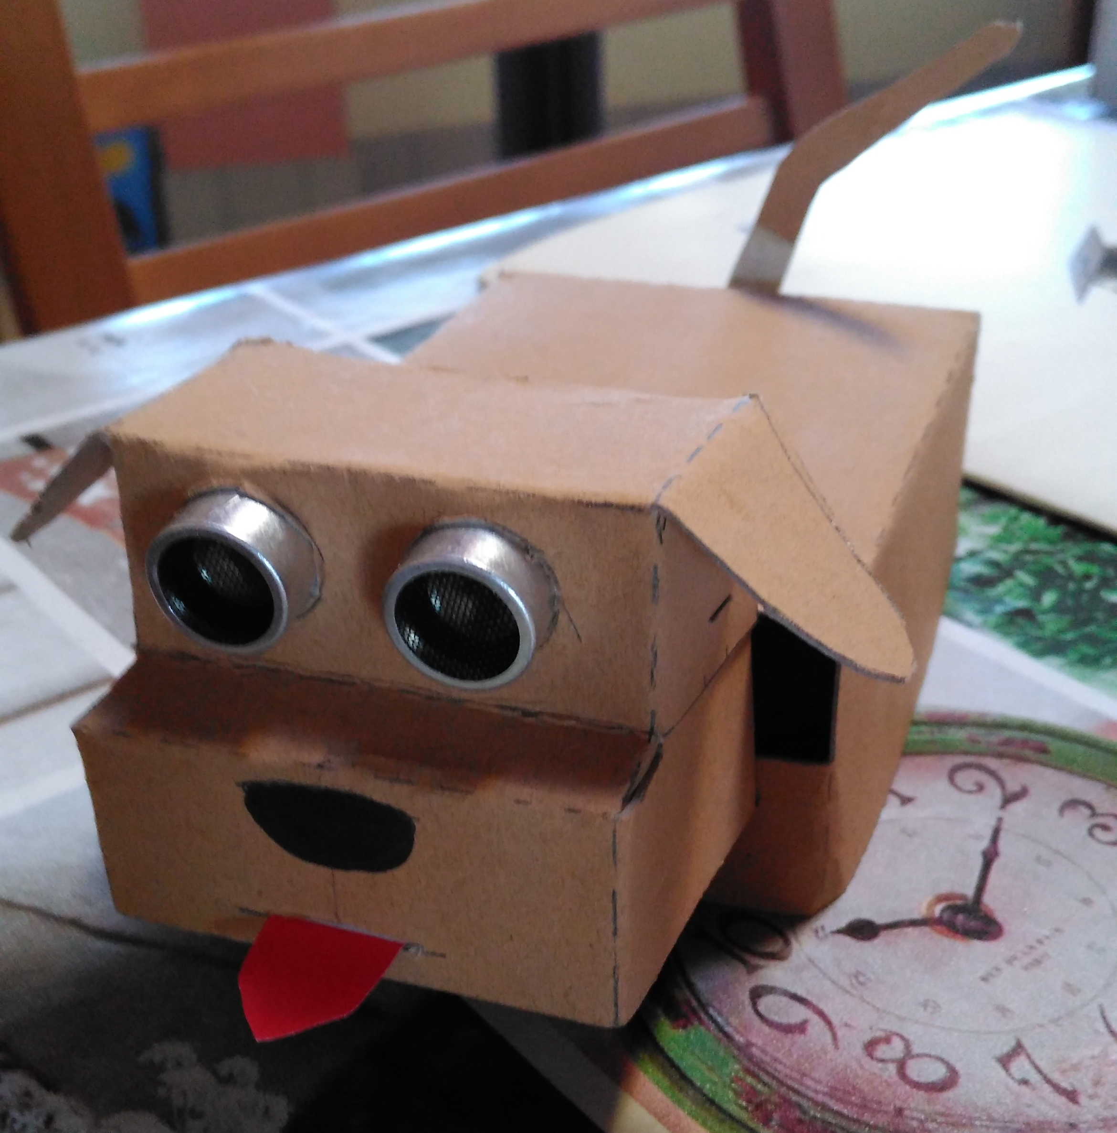
Mount Doggy Basic - a TJBot companion with superdog vision!
Instruction: Create your own Doggy – 4c
Insert and wire HC-SR04 sensor to TJBot (no need for breadboard).
Build a leash keeping connectors together… or you can braid them ☺
WARNING: pay attention to connect the right PINs to avoid damages to components.
Description | From TJBot to Doggy’s eyes
Type of connectors | Female to Female
Pin 25 - Ground | Blue to Ground
Pin 23 - GPIO 11 - Echo | Green to Echo
Pin 21 - GPIO 09 - Trigger | Yellow to Trigger
Pin 4 - 5V | Orange to VCC
Enjoy your Doggy Basic
Please, share your experience on Doggy's House!!!
Agenda

Slide 12
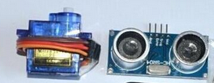
Mount Doggy Standard - a TJBot companion with superdog vision and a cute tail!
Instruction: Create your own Doggy – 5a
Get and Print/Copy DOGGY STANDARD design file - Print/reproduce only the Tail and advanced Sheet
Cut all the red lines using a cutter and a scissor. If you plan to use superdog vision, remind to cut eyes too.
fold up or down cyan and green lines
fold up
fold down
Agenda

Slide 13
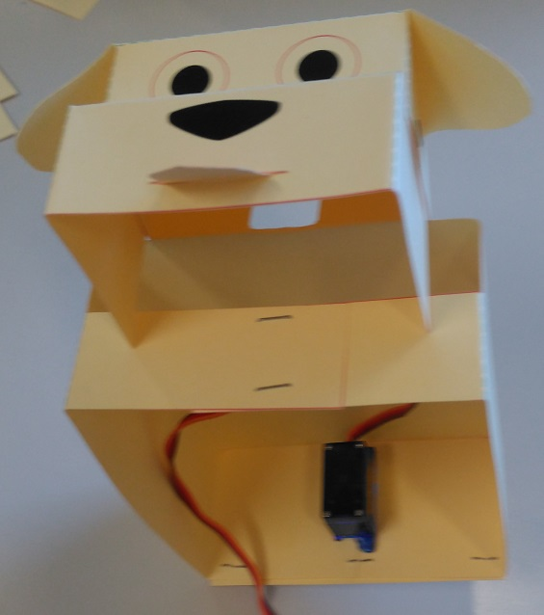
Mount Doggy Standard - a TJBot companion with superdog vision and a cute tail!
Instruction: Create your own Doggy – 5b
Doggy is folded up & down (and I forget to cut eyes ☹ )
staple left and right ears
staple neck and back
insert tongue and mount servo motor as shown in figure
(if you forget to cut eyes, remove it and insert HC-SR04 sensor)
Agenda

Slide 14
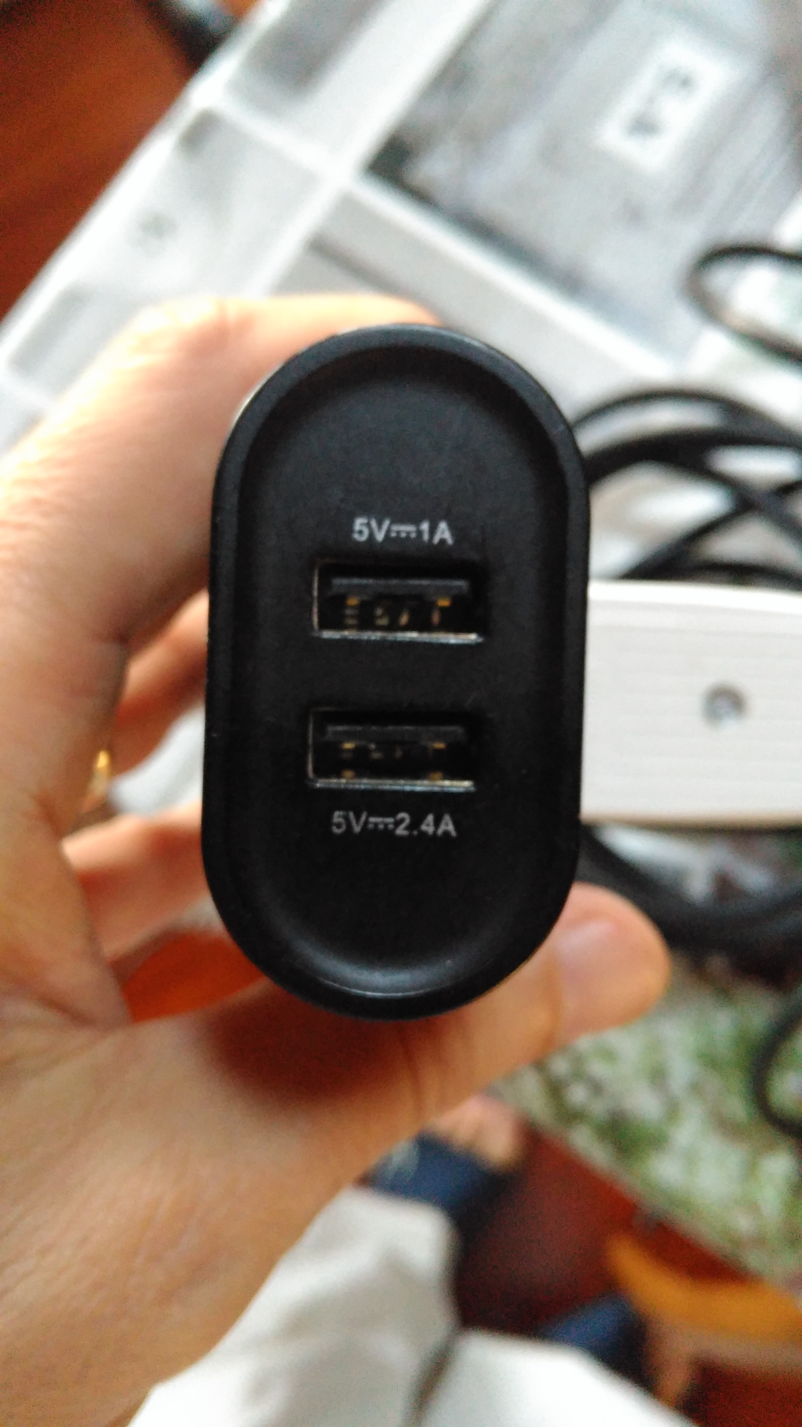
Mount Doggy Standard - a TJBot companion with superdog vision and a cute tail!
Instruction: Create your own Doggy – 5c
Wire HC-SR04 sensor and SG-90 servo motor to TJBot (look at the picture to insert servo with the right orientation). A breadboard could make this task easier, but it’s not strictly required.: fix breadboard to Doggy’s back (upside down).
Build a leash keeping connectors together… or you can braid them ☺
WARNING: pay attention to connect the right PINs to avoid damages to components.
Description | From TJBot | From Doggy’s eyes | From Doggy’s tail
Type of connectors | Female to Male | Male to Female | Male to Male
Pin 25 - Ground | Blue | Blue to Ground | Brown to Brown (Ground)
Pin 23 - GPIO 11 - Echo | Violet | Green to Echo
Pin 21 - GPIO 09 - Trigger | Gray | Yellow to Trigger
Pin 4 - 5V White | Orange to VCC | Red to Red (5V)
Pin 24 - GPIO 08 Data servo motor (tail) | Black | Orange to Orange (Data servo motor)
WARNING: Using Doggy, TJBot is requiring more power than usual. Power it with 2.4A and everything will be fine!
Agenda

Slide 15
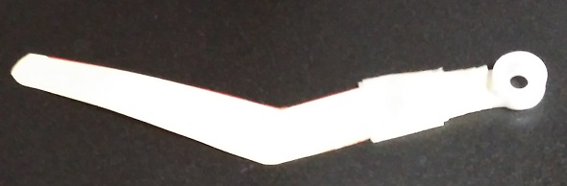
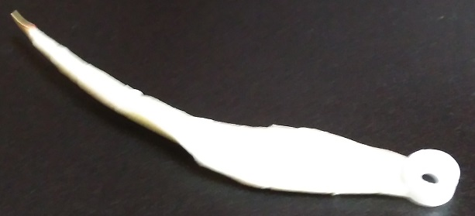
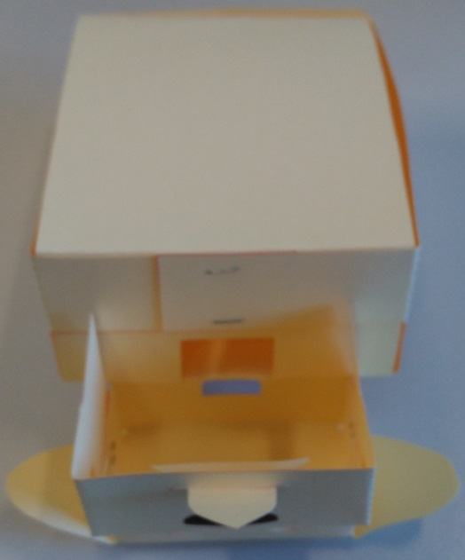
Mount Doggy Standard - a TJBot companion with superdog vision and a cute tail!
Instruction: Create your own Doggy – 5d
Build tail (version #1). Get Servo arm and tape tail to it.
Build tail (version #2).
Tail is a personality trait. Use your imagination and try different tails. In the following photo, I wrapped tail starting from servo arm to tail’s end creating a rotation effect.
(optional) - print and cut standard belly component from Optional/Advanced Parts design sheet
Enjoy your Doggy Standard
Please, share your experience on Doggy's House!!!
Agenda

Slide 16
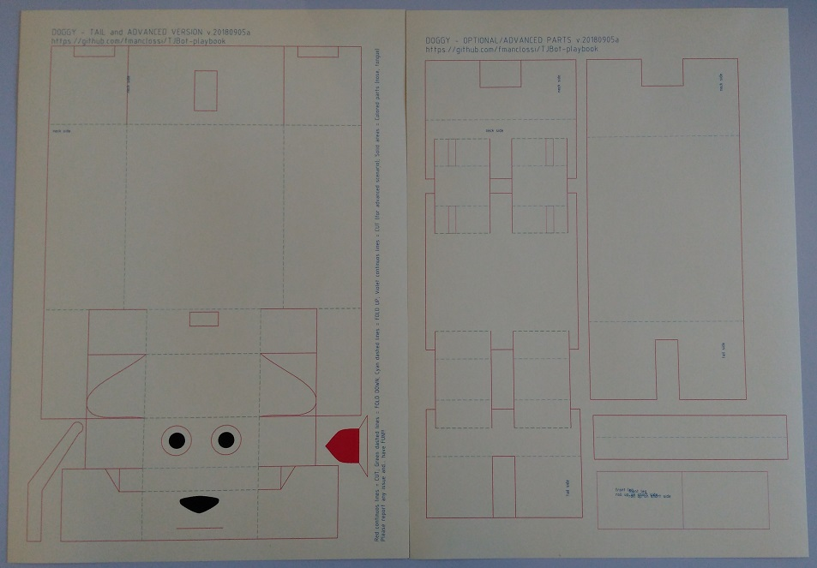
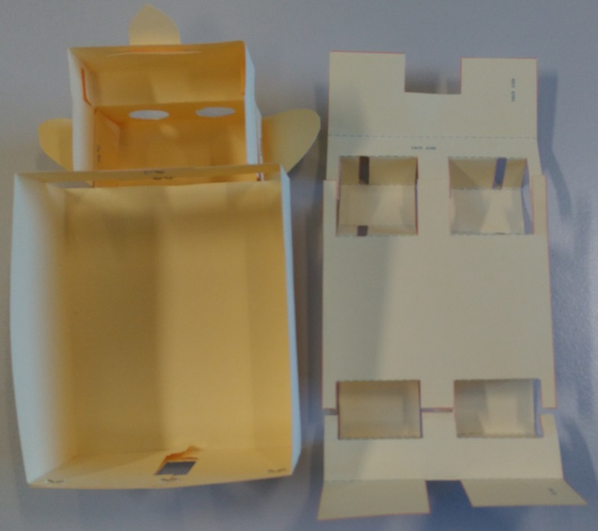
Mount Doggy Premium - a TJBot companion with superdog vision, a cute tail and two legs!
Instruction: Create your own Doggy – 6a
Get and Print/Copy DOGGY Premium design files
Cut and fold as described for previous Doggy’s versions.
Agenda

Slide 17
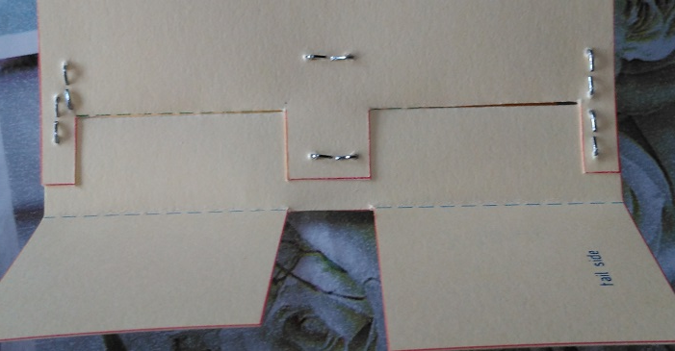
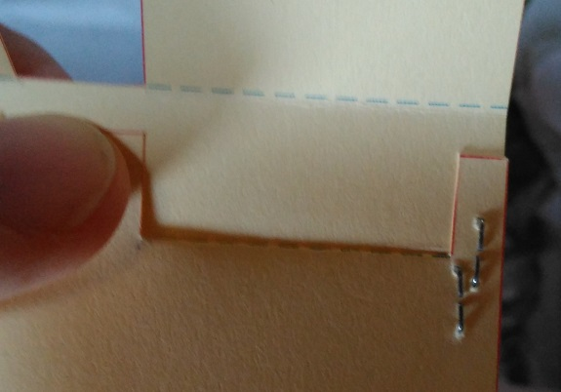
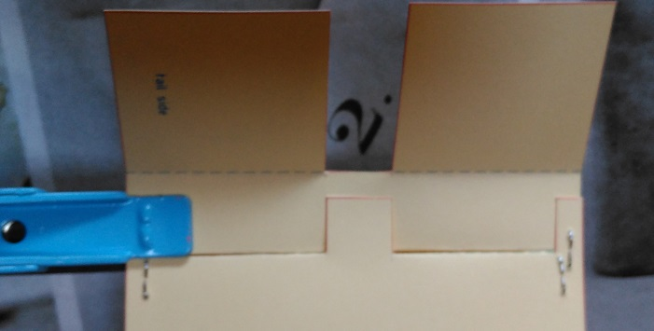
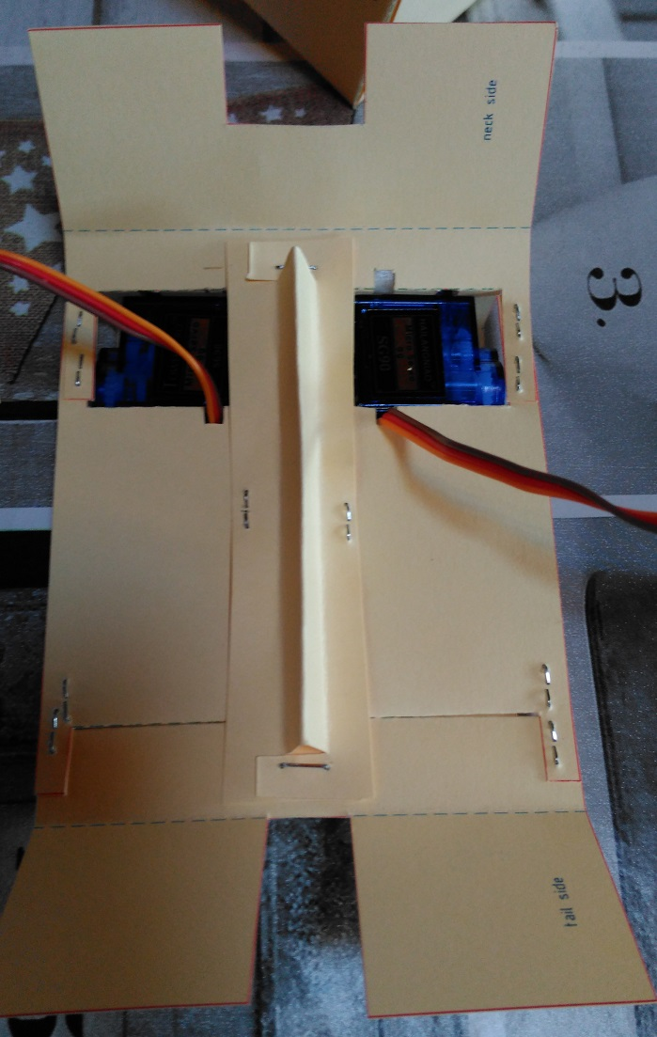
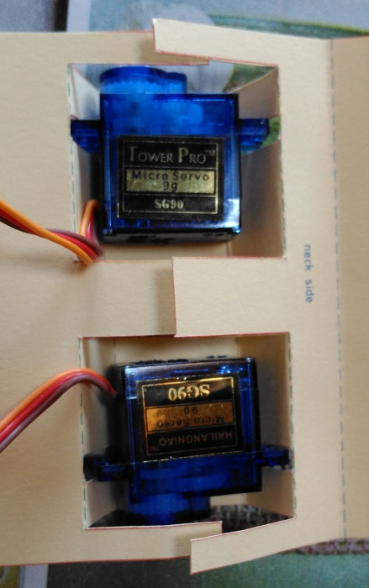
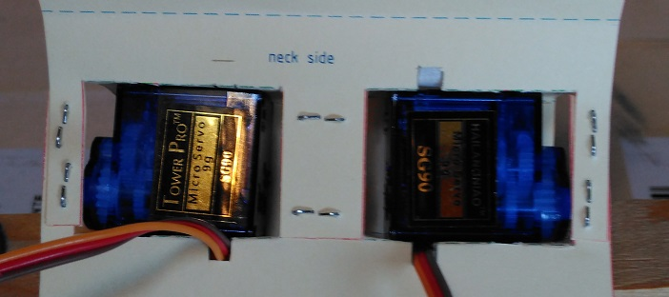
Mount Doggy Premium - a TJBot companion with superdog vision, a cute tail and two legs!
Instruction: Create your own Doggy – 6b
Clip hind legs
Mount servo motors for front legs and clip to fix them
(optional and in beta version) If you want to tighten up belly component (e.g. if you print it on 200gr/m² A4 paper), print, cut, fold and clip the beam component
Agenda

Slide 18
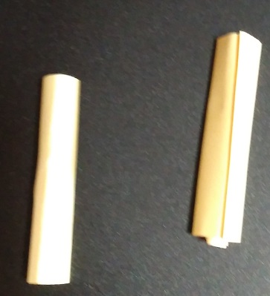
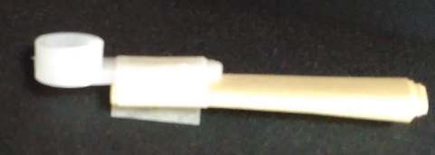
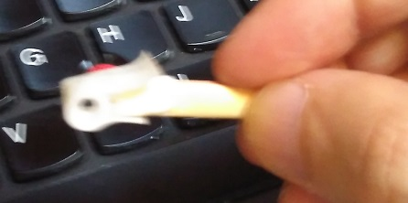
Mount Doggy Premium - a TJBot companion with superdog vision, a cute tail and two legs!
Instruction: Create your own Doggy – 6c
Cut and Roll up front legs on shortest side. TIP: Fix leg to servo arm as shown in picture, leaving space to attach it to servo and fixing leg to the external part. As tail, legs are personality traits. Use your imagination and try different legs. In the following photo, I wrapped legs starting from servo arm to leg’s end.
Wire HC-SR04 sensor and SG-90 servo motor (tail, right leg/arm, left leg/arm) to TJBot.
A breadboard is recommended. Fix breadboard to Doggy’s belly.
Build a leash keeping connectors together… or you can braid them ☺
WARNING: pay attention to connect the right PINs to avoid damages to components.
Description | From TJBot | From Doggy’s eyes | From Doggy’s tail | From Doggy’s left arm | From Doggy’s Right arm
Type of connectors | Female to Male | Male to Female | Male to Male | Male to Male | Male to Male
Pin 38 - GPIO 20 - Data servo motor (right Doggy’s arm) | Green |  |  |  | Violet to Orange (data servo motor)
Pin 40 - GPIO 21 - Data servo motor (left Doggy’s arm) | Yellow |  |  | Violet to Orange (data servo motor)
Pin 25 - Ground | Blue | Blue to Ground | Brown to Brown (Ground) | Brown to Brown (Ground) | Brown to Brown (Ground)
Pin 23 - GPIO 11 - Echo | Violet | Green to Echo
Pin 21 - GPIO 09 - Trigger | Gray | Yellow to Trigger
Pin 4 - 5V | White | Orange to VCC | Red to Red (5V) | Red to Red (5V) | Red to Red (5V)
Pin 24 - GPIO 08 - Data servo motor (tail) | Black |  | Orange to Orange (Data servo motor)
Please, share your experience on Doggy's House!!!
Agenda

Slide 19
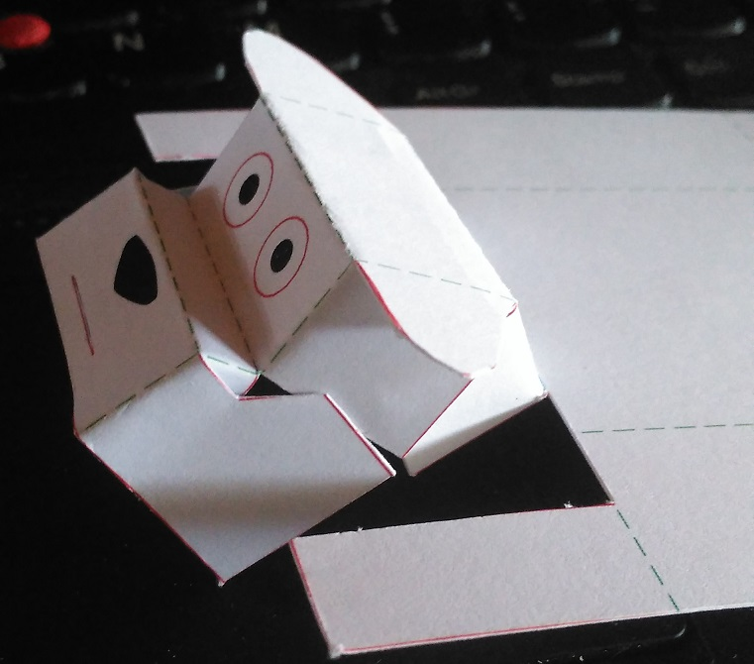
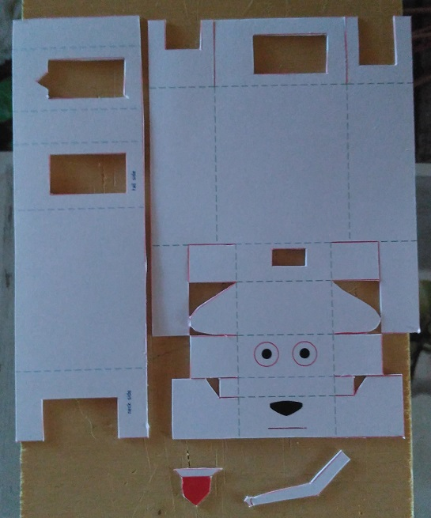
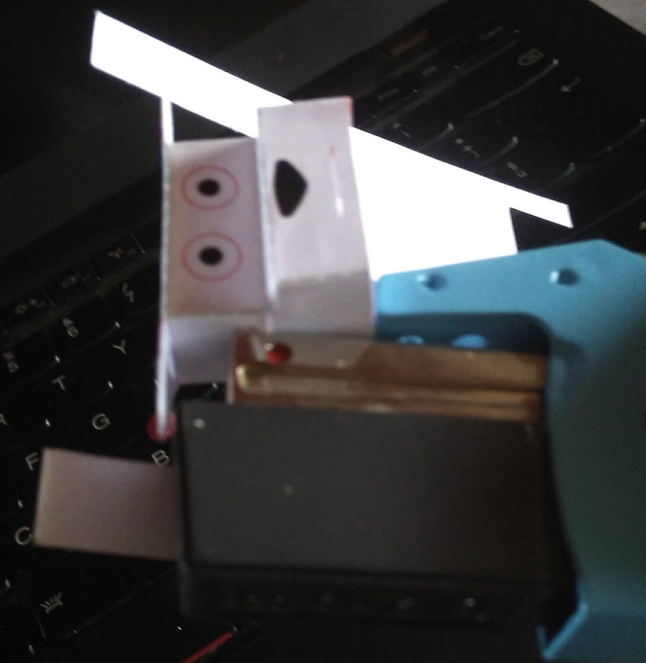
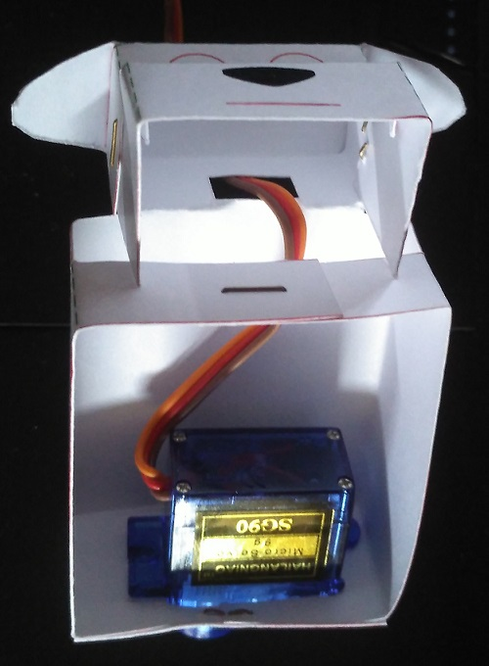
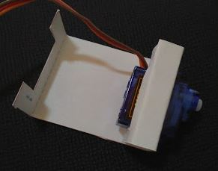
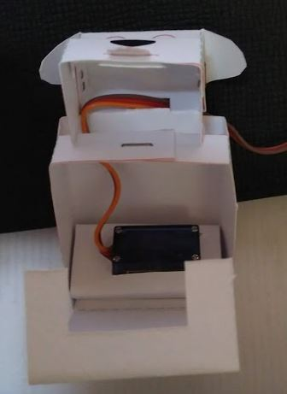
Mount MiniDoggy – the cutest tail in TJworld
Instruction: Create your own Doggy – 7a
Get and Print/Copy MiniDoggy design file and Cut all the red lines using a cutter and a scissor.
fold up or down green and green lines
staple ears
mount servo motor (extended version)
Staple neck and back; mount servo motor (simplest version)
(optional) If you like, or if you printed MiniDoggy on standard printer paper, fold and mount MiniDoggy's belly
Agenda

Slide 20
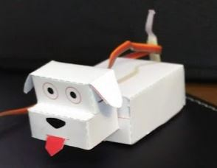
Mount MiniDoggy – the cutest tail in TJworld
Instruction: Create your own Doggy – 7b
wire servo to TJBot (no need for breadboard)
Build tail (version #1). Get Servo arm and tape tail to it.
Description | From TJBot | From MiniDoggy’s tail
Type of connectors | Female to Male | Male to Male
Pin 25 - Ground | Blue | Violet to Brown (Ground)
Pin 4 - 5V | White | Red to Red (5V)
Pin 24 - GPIO 08 - Data servo motor (tail) | Black | Yellow to Orange (Data servo motor)
Build tail (version #2). Tail is a personality trait. Use your imagination and try different tails. In the following photo, I wrapped tail starting from servo arm to tail’s end creating a rotation effect that I like.
insert tongue and enjoy your MiniDoggy
Agenda

Slide 21
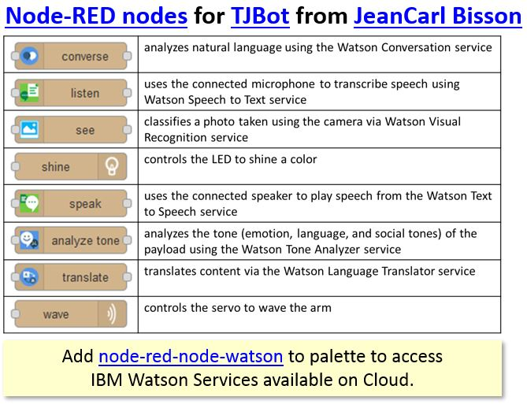
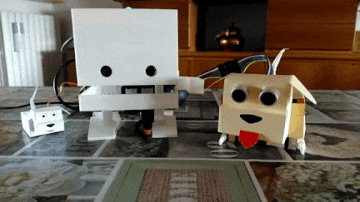
Instruction: Setup and test Doggy
Instruction: Setup and test Doggy - 8
First of all, if you never setup Node-Red environment on TJbot, follow JCBisson Node-Red nodes for TJBot - setup instructions.
Everything ok? Excellent! You can already follow other TJBot labs provided in TJBot Playbook GitHub space!
But... we want a Doggy!!!
Before let it run through digital fields, we have to test its features and tune up some little things.
Apply the following setup instructions to your version:
Setup and Test Doggy superdog vision (HC-SR04)
Setup and Test Doggy tail (SG-90)
Setup and Test Doggy front legs (SG-90)
Agenda

Slide 22

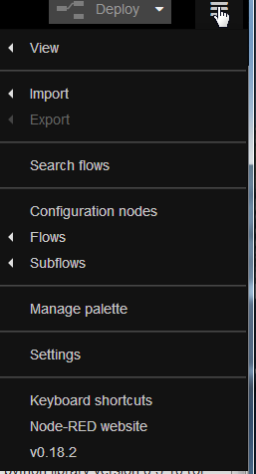
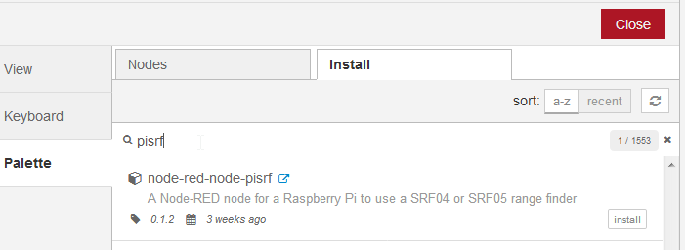
Instruction: Setup and Test Doggy superdog vision (HC-SR04)
Instruction: Setup and test Doggy vision – 9a
Apply to: Doggy Basic, Doggy Standard, Doggy Premium
Doggy is a superdog! It has a supervision powered by a very easy to use sensor named HC-SR04. This is a ultrasonic sonar. It emits a sound that travels through the air. If there is an object on its path, the sound will bounce back to the sensor that evaluate travel time to calculate how far is the object. HC-SR04 is able to detect object from 2cm to 400cm (1” to 13 feet). Using HC-SR04 in Node-Red is very easy!
Follow wiring instructions for your Doggy version. Note: If you've changed PINs connections, modify the example according to your layout.
point your browser to Node-Red URL - http://«TJBot_ip_address»:1880 and verify that TJBot and Node-red are fully functional
install node-red-node-pisrf node to manage HC-SR04 and superdog vision.
open Node-Red Dashboard.
click on Menu
select MANAGE PALETTE
choose INSTALL tab
search package inserting "pisrf" test in search field
push INSTALL button and wait successful installation.
press CLOSE to return to Node-Red dashboard.
Agenda

Slide 23
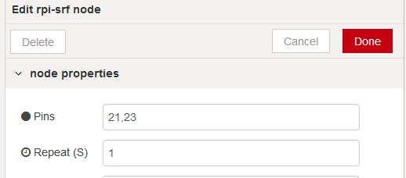
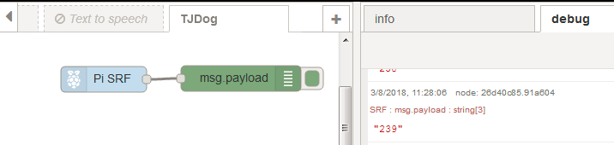
Instruction: Setup and Test Doggy superdog vision (HC-SR04)
Instruction: Setup and test Doggy vision – 9b
Apply to: Doggy Basic, Doggy Standard, Doggy Premium
Test superdog vision creating the following flow using RPI-SRF and DEBUG nodes
drag RPI-SRF node to working area; drag DEBUG node, too. Connect RPI-SRF to DEBUG.
double-click RPI-SRF node and configure it as shown in picture on the right.
push DEPLOY button and verify that in the DEBUG area you'll get the distance (in centimetres) between Doggy's head and an obstacle.
That’s all! We’re ready to build a story with Doggy's superdog eyes!
Agenda

Slide 24


Instruction: Setup and Test Doggy tail (SG-90)
Instruction: Setup and test Doggy tail – 10a
Apply to: MiniDoggy, Doggy Standard, Doggy Premium
Agenda
Doggy is a cute dog! It has tail that wags to show its happiness. A little servo motor (SG-90) moves the tail. Using SG-90 in Node-Red is very easy! Follow wiring instructions for your Doggy version.
Note: If you've changed PINs connections, modify the example according to your layout.
point your browser to Node-Red URL - http://«TJBot_ip_address»:1880 and verify that TJBot and Node-red are fully functional
install node-red-node-pi-gpiod node to manage SG-90 servo motor.
open Node-Red Dashboard.
click on Menu
select MANAGE PALETTE
choose INSTALL tab
search package inserting "pigpiod" test in search field
push INSTALL button and wait successful installation.
press CLOSE to return to Node-Red dashboard.

Slide 25



Instruction: Setup and Test Doggy tail (SG-90)
Instruction: Setup and test Doggy tail – 10b
Apply to: MiniDoggy, Doggy Standard, Doggy Premium
Agenda
take away Doggy's tail. We have to set the right position to avoid damages to it.
tune tail position creating the following flow using PI-GPIOD and INJECT nodes dragging three times INJECT node to working area (you'll get three nodes); drag PI-GPIOD node, too. Connect INJECT nodes to PI-GPIOD.
double-click the first INJECT node and configure it as shown in the following picture. It changes name to "Set TAIL to CENTER“
as previous step, configure other INJECT nodes with 0 and 100 integer value. New names will be "Set TAIL to RIGHT" and "Set TAIL to LEFT".
double-click PI-GPIOD node and configure it as shown in picture.
push DEPLOY button.
Push "Set TAIL to CENTER" inject node. Servo motor should reach middle position. Attach tail to Doggy in RAISED position.
Push "Set TAIL to LEFT" inject node. Does tail go to Doggy's left side? If not, verify that servo is mounted according with your Doggy's version.
Push "Set TAIL to RIGHT" inject node. Does tail go to Doggy's right side? If not, verify that servo is mounted according with your Doggy's version.
That’s all! We’re ready to build a story with Doggy’s cute tail!

Slide 26


Instruction: Setup and Test Doggy front legs (SG-90)
Instruction: Setup and test Doggy front legs – 11a
Apply to: Doggy Premium
Agenda
Doggy Premium is a strong dog! It can raise up on its front legs to intimidate unknown object and people. Two little servo motors (SG-90) powers front legs. Follow wiring instructions for your Doggy version.
Note: If you've changed PINs connections, modify the example according to your layout.
Prerequisite: install node-red-node-pi-gpiod as described in previous slide
point your browser to Node-Red URL - http://«TJBot_ip_address»:1880 and verify that TJBot and Node-red are fully functional
take away Doggy's legs. We have to set the right position to avoid damages to them.
tune legs position creating the following flow using PI-GPIOD and INJECT nodes dragging four times INJECT node to working area (you'll get four nodes); drag twice PI-GPIOD node, too (You'll get two nodes). Connect two INJECT nodes per PI-GPIOD.

Slide 27



Instruction: Setup and Test Doggy front legs (SG-90)
Instruction: Setup and test Doggy front legs – 11b
Apply to: Doggy Premium
Agenda
double-click the first INJECT node and configure it as shown in picture. It changes name to "Set DOGGY LEFT ARM to DOWN“.
configure other INJECT nodes as in following table
Node | Name | Value
Inject #2 | Set DOGGY LEFT ARM to UP | 0
Inject #3 | Set DOGGY RIGHT ARM to DOWN | 0
Inject #4 | Set DOGGY RIGHT ARM to UP | 100
double-click PI-GPIOD nodes and configure them as shown in following pictures and push DEPLOY button.

Slide 28



Instruction: Setup and Test Doggy front legs (SG-90)
Instruction: Setup and test Doggy front legs – 11c
Apply to: Doggy Premium
Agenda
Push "Set DOGGY LEFT ARM to UP" and "Set DOGGY RIGHT ARM to UP" inject nodes. Attach front legs to let Doggy to its belly.
Push "Set DOGGY LEFT ARM to DOWN" and "Set DOGGY RIGHT ARM to DOWN" inject nodes. Does DOGGY raised up? If not, verify that servos are mounted as described in provided instructions.
That’s all! We’re ready to build a story with Doggy’s front legs!

Slide 29
Tales of two Doggies
Once upon a time…
TJBot loves pets even they could be noisy. He/Her owns two dogs, Doggy and MiniDoggy.
Doggy is a very careful watchdog. Nothing and no one can pass in front of it without getting a strong barking.
Mini Doggy is more distracted one, it doesn’t look at what happens around it but it’s happy to play with TJBot.
In the following scenarios, we follow TJBot and its doggies in some funny stories learning how IBM solutions could be applied to real life examples.
Every tale includes Doggy requirement, Skills, Age, Knowledge acquired and preparation steps.
Tales available:
Doggy barks and wags its tail if an object is less than 30cm away
Doggy is a greedy pet and needs to eat better and exercise
We Need You!
Submit your stories to expand Doggy's behaviour :)

Slide 30

Instruction: Tale 1 - Nothing and no one can pass without getting a strong barking from Doggy. TJBot calms it getting a cute tail wagging.
Tale1.Scene1 - Create a flow that makes Doggy say “BARK!” if an object is less than 30cm away
Tale1.Scene2 – Make Doggy barking (a real barking!) if an object is less than 30cm away
Tale1.Scene3 – Smart barking, just one time, please!
Tale1.Scene4 – Doggy is happy and wags its tail
Tale1.Scene5 - TJBot wakes up when Doggy start barking and calms it recognizing the object
Challenges included
Agenda
Level: some task could be tricky but could be performed under adult’s guidance

Slide 31



Instruction: Tale1.Scene1 - Doggy say “BARK!” if an object is less than 30cm away
Instruction: Doggy says “BARK!” T01S01a
Doggy is a very careful watchdog. Nothing and no one can pass without getting a strong barking.
Requirement: TJBot, Doggy (Basic, Standard or Premium) – already setup and tested
Skill: Node-Red (basic level)
Age: 8+
Knowledge acquired: Sonar sensor usage, test condition, set value to variable, debugging
Preparation steps (usually performed by IBMers, Teachers…):
point your browser to Node-Red Dashboard - http://«TJBot_ip_address»:1880
verify that TJBot is fully functional and node-red is working as expected.
disable every existing Flow (double-click each label, set Status to “Disabled”, press “Done” to close)
point your browser to Node-Red Dashboard - http://«TJBot_ip_address»:1880
create a new Flow
double-click Flow label and rename it to “Tale1.Scene1”. Press “Done” to close.
drag PI-SRF node to the working area
double-click PI-SRF node and configure it as shown in the following picture
Agenda
Level: some task could be tricky but could be performed under adult’s guidance

Slide 32



Instruction: Tale1.Scene1 - Doggy say “BARK!” if an object is less than 30cm away
Instruction: Doggy says “BARK!” T01S01b
drag a SWITCH node to the working area
double-click SWITCH node and configure it as shown in the following picture
drag a line from the output of the first node to the input of the second one
Agenda

Slide 33



Instruction: Tale1.Scene1 - Doggy say “BARK!” if an object is less than 30cm away
Instruction: Doggy says “BARK!” T01S01c
drag a CHANGE node to the working area
configure CHANGE node setting the message to “BARK!”
connect the first output from SWITCH node to the input of CHANGE one
Agenda

Slide 34


Instruction: Tale1.Scene1 - Doggy say “BARK!” if an object is less than 30cm away
Instruction: Doggy says “BARK!” T01S01d
drag a DEBUG node to the working area
connect its input to the output of CHANGE node
press DEPLOY button and switch to “debug” tab (if not already highlighted)
What happen when you put an object near to Doggy’s eyes?
Excellent! But we want a strong bark not a text on dashboard.
We get it in the next scene!
Agenda

Slide 35


Instruction: Tale1.Scene2 –Doggy barks if an object is less than 30cm away
Instruction: Doggy barks - T01S02a
Requirement: TJBot, Doggy (Basic, Standard or Premium) – already setup and tested
Skill: Node-Red (basic level)
Age: 8+
Knowledge acquired: Sonar sensor usage, test condition, set value to variable, debugging, play audio
Preparation steps:
point your browser to Node-Red Dashboard - http://«TJBot_ip_address»:1880
verify that TJBot is fully functional and node-red is working as expected (TJBot credentials, too).
verify that Tale1.Scene1 is enabled on dedicated Flow
get a good sound file (WAV format) with a dog barking (e.g. dogbark2.wav)
upload bark sound file to TJBot Desktop using VNC file transfer feature, an USB Key or whatever you like (e.g. /home/pi/Desktop/dogbark2.wav). P.S: You can download it directly using TJBot browser :D
test TJBot speaker with bark audio file
point browser to Node-Red Dashboard http://«TJBot_ip_address»:1880
create a new Flow
double-click Flow label and rename it to “Tale1.Scene2”. Press “Done” to close.
double-click “Tale1.Scene1” Flow label and set status to “Disabled”. Press “Done” to close.
select all nodes in “Tale1.Scene1” Flow drawing an area over them
press CTRL+C keys to copy.
Agenda
Level: some task could be tricky but could be performed under adult’s guidance

Slide 36


Instruction: Tale1.Scene2 –Doggy barks if an object is less than 30cm away
Instruction: Doggy barks - T01S02b
click on “Tale1.Scene2” Flow label
press CTRL+V keys to paste nodes. When you find the best place to paste them, right click to save positions.
delete DEBUG node (click on it and press DEL key)
double-click SWITCH node and modify it as shown in the following picture
drag SPEAK node (from TJBot palette) to the Working area
Agenda

Slide 37

Instruction: Tale1.Scene2 –Doggy barks if an object is less than 30cm away
Instruction: Doggy barks - T01S02c
double-click SPEAK node, select BOT according to your environment, set MODE to “Play” and set NAME to “Bark”
connect it to CHANGE node and press DEPLOY button
Do you get a strong barking when you put an object near to Doggy’s eyes? If not, verify prerequisites (e.g. audio power turned on…)
What happen if the object stays near Doggy?
Congratulation! You’re ready to move to the next level! Let’s make Doggy a little smarter!
Agenda

Slide 38

Instruction: Tale1.Scene3 – Smart barking, just one time, please!
Instruction: Doggy smart barks - T01S03a
Requirement: TJBot, Doggy (Basic, Standard or Premium) – already setup and tested
Skill: Node-Red (basic level)
Age: 8+
Knowledge acquired: Sonar sensor usage, test condition, set value to variable, debugging, play audio, use global variables
Preparation steps:
point your browser to Node-Red Dashboard - http://«TJBot_ip_address»:1880
verify that TJBot is fully functional and node-red is working as expected (TJBot credentials, too).
verify that Tale1.Scene2 is enabled on dedicated Flow
point your browser to Node-Red Dashboard - http://«TJBot_ip_address»:1880
create a new Flow
double-click Flow label and rename it to “Tale1.Scene3”. Press “Done” to close.
double-click “Tale1.Scene2” Flow label and set status to “Disabled”. Press “Done” to close.
select all nodes in “Tale1.Scene2” Flow drawing an area over them
press CTRL+C keys to copy.
click on “Tale1.Scene3” Flow label
press CTRL+V keys to paste nodes. When you find the best place to paste them, right click to save positions.
delete connection between SWITCH and CHANGE nodes, and make space in the flow
Agenda
Level: some task could be tricky but could be performed under adult’s guidance

Slide 39



Instruction: Tale1.Scene3 – Smart barking, just one time, please!
Instruction: Doggy smart barks - T01S03b
drag twice CHANGE node to Working area. Drag SWITCH node, too.
double-click upper new CHANGE node and configure it as follow. Press “Done” to close.
double-click other new CHANGE node and configure it as the image on the right.
Agenda

Slide 40


Instruction: Tale1.Scene3 – Smart barking, just one time, please!
Instruction: Doggy smart barks - T01S03c
double-click new SWITCH node and configure it as follow. Press “Done” to close.
*(if needed, rearrange nodes to make space and) connect as show in picture and press DEPLOY button
What happen when an obstacle reaches Doggy? As previously, Doggy start barking.
What happen if the object stays near Doggy?
What needs to happen to let Doggy barking again?
Awesome! Doggy is growing up smarter, step by step! It’s time to shake its tail!
Agenda

Slide 41

Instruction: Tale1.Scene4 –Doggy is happy and wags its tail!
Instruction: Doggy shakes its tail- T01S04a
Requirement: TJBot, MiniDoggy or Doggy (Basic, Standard or Premium) – already setup and tested
Skill: Node-Red (basic level)
Age: 8+
Knowledge acquired: Servo motor and Sonar sensor usage, test condition, set value to variable, use random values, create loop
Preparation steps:
point your browser to Node-Red Dashboard - http://«TJBot_ip_address»:1880
verify that TJBot is fully functional and node-red is working as expected (TJBot credentials, too).
verify if LOOPTIMER is installed. If not, install node-red-contrib-looptimer via “Manage Palette”
(Doggy version only) verify that Tale1.Scene3 is enabled and working on dedicated Flow
point your browser to Node-Red Dashboard and create a new Flow
double-click Flow label and rename it to “Tale1.Scene4”. Press “Done” to close.
(Doggy version only) double-click “Tale1.Scene3” Flow label and set status to “Disabled”. Press “Done” to close.
(Doggy version only) select “Doggy Eyes” and “Less than 30cm” nodes in “Tale1.Scene3” Flow. Press CTRL+C keys to copy them. Click on “Tale1.Scene4” Flow label. Press CTRL+V keys to paste them.
(MiniDoggy only) drag INJECT node to Working area. Double-click it and configure as in following picture
Agenda
Level: some task could be tricky but could be performed under adult’s guidance

Slide 42



Instruction: Tale1.Scene4 –Doggy is happy and wags its tail!
Instruction: Doggy shakes its tail- T01S04b
(MiniDoggy only) drag RANDOM node to Working area. Double-click it and configure as in following picture. rearrange and connect nodes
drag LOOPTIMER node to Working area. Configure it to fire 30 times, every 0.2 seconds.
Agenda

Slide 43


Instruction: Tale1.Scene4 –Doggy is happy and wags its tail!
Instruction: Doggy shakes its tail- T01S04c
drag RANDOM node to Working area. Configure it to send an integer between 0 and 100.
drag PI-GPIOD node to Working Area and configure it to PIN 24 (GPIO 8)
Agenda

Slide 44


Instruction: Tale1.Scene4 –Doggy is happy and wags its tail!
Instruction: Doggy shakes its tail- T01S04d
connect and rearrange, if needed, as show in the following picture. Press DEPLOY button
(Doggy version only)
What happen when an obstacle reaches Doggy?
What happen if the object stays near Doggy?
Fantastic! Doggy is growing up smarter, step by step!
(MiniDoggy version only)
What happens when you press “Simulated Doggy’s Eyes” INJECT node?
Why the tail shakes only some time and not always?
HINT: add a debug node to show “Simulated Distance Measurement” output. Call it “Distance” and press DEPLOY. Press again “Simulated Doggy’s Eyes” INJECT node
Agenda

Slide 45

Challenge T1C1: Add scene3 elements to make Doggy barking and wagging tail when an object is closer than 30cm.
Click to show “one of many” solution!!!
Do. Or do not. There is no try.
Agenda
Level: some task could be tricky but could be performed under adult’s guidance

Slide 46
Instruction: Tale1.Scene5 – TJBot wakes up when Doggy start barking and calms it down
Instruction: TJBot wakes up and calm Doggy - T01S05a
Requirement: TJBot, MiniDoggy or Doggy (Basic, Standard or Premium) – already setup and tested
Skill: Node-Red (basic level)
Age: 10+
Knowledge acquired: Servo motor and Sonar sensor usage, test condition, set value to variable, TJBot capabilities (Text to Speech, Visual Recognition, Wave)
Preparation steps:
point your browser to Node-Red Dashboard - http://«TJBot_ip_address»:1880
verify that TJBot is fully functional and node-red is working as expected (TJBot credentials, too).
verify if LOOPTIMER is installed from previous Scenes. If not, install node-red-contrib-looptimer via “Manage Palette”
(Doggy version only) verify that Tale1.Scene3 is enabled and working on dedicated Flow
Remember to check TJBot credentials
There are several steps blocks in this scene according to Doggy version used
Steps (part 1):
point your browser to Node-Red Dashboard - http://«TJBot_ip_address»:1880
create a new Flow
double-click Flow label and rename it to “Tale1.Scene5”.
Press “Done” to close.
disable any other active flow.
select all nodes in “Tale1.Scene3” Flow. Press CTRL+C keys to copy them.
Click on “Tale1.Scene5” Flow label. Press CTRL+V keys to paste them.
Agenda
Level: some task could be tricky but could be performed under adult’s guidance

Slide 47

Instruction: Tale1.Scene5 – TJBot wakes up when Doggy start barking and calms it down
Instruction: TJBot wakes up and calm Doggy - T01S05b
Steps (part 2 - optional - Doggy Premium only):
drag twice PI-GPIOD node to working area (you'll get two nodes)
double-click PI-GPIOD nodes and configure them as shown in pictures on the right.
duplicate PI_GPIOD nodes (copy and paste)
drag four times CHANGE node to working area and configure them as shown in picture following the table provided
Node | Name | Value
Change #1 | Set DOGGY LEFT ARM to DOWN | 100
Change #2 | Set DOGGY LEFT ARM to UP | 0
Change #3 | Set DOGGY RIGHT ARM to DOWN | 0
Change #4 | Set DOGGY RIGHT ARM to UP | 100
Agenda

Slide 48



Instruction: Tale1.Scene5 – TJBot wakes up when Doggy start barking and calms it down
Instruction: TJBot wakes up and calm Doggy - T01S05c
Steps … continue (part 2 - opional - Doggy Premium only):
connect and rearrange, if needed, as show in the following picture.
press DEPLOY button.
What happens moving object in front of Doggy?
(HINT: use comment nodes - Things can grow up very fast and one comment can save your life)
Steps (part 3): Let's TJBot take on the stage!
drag once OUTPUT LINK node to working area beside SPEAK node
drag one INPUT LINK node to working area below the flow. Double-click it and name it "Doggy is barking"
double-click OUTPUT NODE and link it to "Doggy is barking"
Agenda

Slide 49




Instruction: Tale1.Scene5 – TJBot wakes up when Doggy start barking and calms it down
Instruction: TJBot wakes up and calm Doggy - T01S05d
Steps… continue (part 3): Let's TJBot take on the stage!
drag TJBot's SEE and SPEAK, TEMPLATE (and DEBUG) nodes from Palette and connect them as in picture
configure SEE, SPEAK and TEMPLATE nodes as following
This is the code inserted in FUNCTION to copy and paste:
Calm down, Doggy. That's only a {{payload.0.class}} !
Agenda

Slide 50

Instruction: Tale1.Scene5 – TJBot wakes up when Doggy start barking and calms it down
Instruction: TJBot wakes up and calm Doggy - T01S05e
Steps… continue (part 3): Let's TJBot take on the stage!
drag twice TJBot's SHINE node to Working area. Connect and configure them as shown in following picture.
press DEPLOY button.
What happens moving object in front of Doggy?
What happens if an object goes away and then back while TJBot is talking?
Probably you (or your students) noticed that Doggy and TJBot try to identify multiple objects mixing barking and speaking. This is bad.
(IBMers/Teachers hint: this is the same solution used in Tale2.Scene2 - look at it to get the details)
Agenda

Slide 51

Instruction: Tale1.Scene5 – TJBot wakes up when Doggy start barking and calms it down
Instruction: TJBot wakes up and calm Doggy - T01S05f
Steps… continue (part 3): change flow as in following picture and retry (changed nodes are highlighted).
TJBot and Doggy are more realistic?
Agenda

Slide 52

Instruction: Tale1.Scene5 – TJBot wakes up when Doggy start barking and calms it down
Instruction: TJBot wakes up and calm Doggy - T01S05g
Steps (part 4): Doggy is calmed and happy When Doggy is calm, it shakes its tail and go down on its belly.
modify flow as shown in the following figure (hint: copy nodes from previous flow)
What happen when an obstacle reaches Doggy?
What happen if the object stays away from Doggy?
What happen if the object stays in front of Doggy’s eyes?
Agenda

Slide 53

Instruction: Tale 2 – Doggy loves his treats. He needs to eat healthier and start doing exercises
Doggy is a sweet tooth. It loves treats, cakes and ice cream. Also likes hamburgers, chips, pizza and pasta!
It’s getting fat, so it needs to eat healthier and start doing exercises! But it doesn’t like gymnastic!!!
Scene Index:
Tale2.Scene1 - Stand Up, Doggy - Doggy stands up on its front legs when anything is less that 30cm away
Tale2.Scene2 – Doggy, trying to do push-ups - Doggy does push-ups when anything is less that 30cm away
Tale2.Scene3 – TJBot helps Doggy doing its exercises - When anything is less that 30cm away, TJBot starts counting push-ups for Doggy
Challenges included
Agenda

Slide 54
Instruction: Tale2.Scene1 –Doggy stands up on its front legs when anything is less that 30cm away
Instruction: Doggy stand-up - T02S01a
Requirement: TJBot, Doggy Premium – already setup and tested
Skill: Node-Red (basic level)
Age: 8+
Knowledge acquired: Servo motor and Sonar sensor usage, test condition, set value to variable
Preparation steps:
point your browser to Node-Red Dashboard - http://«TJBot_ip_address»:1880
verify that TJBot is fully functional and node-red is working as expected (TJBot credentials, too).
verify that Tale1.Scene4 is enabled and working on dedicated Flow (or recreate it)
point your browser to Node-Red Dashboard - http://«TJBot_ip_address»:1880 and create a new Flow
double-click Flow label and rename it to “Tale1.Scene5”. Press “Done” to close.
double-click “Tale1.Scene4” Flow label and set status to “Disabled”. Press “Done” to close.
select “Doggy Eyes” and “Less than 30cm”nodes in “Tale1.Scene4” Flow. Press CTRL+C keys to copy them. Click on “Tale1.Scene5” Flow label. Press CTRL+V keys to paste them.
drag twice PI-GPIOD node to working area (you'll get two nodes)
double-click PI-GPIOD nodes and configure them as shown in following pictures.
Agenda
Level: some task could be tricky but could be performed under adult’s guidance

Slide 55


Instruction: Tale2.Scene1 –Doggy stands up on its front legs when anything is less that 30cm away
Instruction: Doggy stand-up - T02S01b
drag four times CHANGE node to working area and configure them as shown in picture following the table provided
Node | Name | Value
Change #1 | Set DOGGY LEFT ARM to DOWN | 100
Change #2 | Set DOGGY LEFT ARM to UP | 0
Change #3 | Set DOGGY RIGHT ARM to DOWN | 0
Change #4 | Set DOGGY RIGHT ARM to UP | 100
connect and rearrange, if needed, as show in the following picture and press DEPLOY button
Anyone scared by Doggy? Don't panic! It's a cute dog.
Agenda

Slide 56


Instruction: Tale2.Scene2 –Doggy does push-ups when anything is less that 30cm away
Instruction: Doggy does push-ups - T02S02a
Requirement: TJBot, Doggy Premium – already setup and tested
Skill: Node-Red (basic level)
Age: 10+
Knowledge acquired: Servo motor and Sonar sensor usage, test condition, set value to variable, Node-red subflow, Problem decomposition
Preparation steps:
point your browser to Node-Red Dashboard - http://«TJBot_ip_address»:1880
verify that TJBot is fully functional and node-red is working as expected (TJBot credentials, too).
verify if LOOPTIMER is installed. If not, install node-red-contrib-looptimer via “Manage Palette”
verify that Tale2.Scene1 is enabled and working on dedicated Flow
Steps (part 1 - just one push-up!):
point your browser to Node-Red Dashboard - http://«TJBot_ip_address»:1880 and create a new Flow. Rename it to “Subflow working area”. Press “Done” to close.
double-click “Tale2.Scene1” Flow label and set status to “Disabled”. Press “Done” to close.
select all nodes in “Tale2.Scene1” Flow. Press CTRL+C keys to copy them. Click on “Subflow working area” Flow label. Press CTRL+V keys to paste them.
select "Set Doggy LEFT ARM DOWN", "Set Doggy RIGHT ARM DOWN", "TJDog LEFT ARM Pin38" and "TJDog RIGHT ARM Pin40" nodes keeping CTRL key pressed.
Copy them on the same flow and select them
Click on Node-Red Menu, click on SUBFLOWS, and select "Selection to SubFlow". Selection will be substituted by a new node, that appears even in palette area.
Level: some task could be tricky but could be performed under adult’s guidance
Agenda

Slide 57





Instruction: Tale2.Scene2 –Doggy does push-ups when anything is less that 30cm away
Instruction: Doggy does push-ups - T02S02b
Steps (part 1… continue):
double-click on created subflow in the Palette area. It opens in Working area and could be edited. Click on value "1" in Inputs selector and connect new input node to CHANGE nodes
click on "Edit Properties" and change name to "Doggy Stand-Up". Press "Done" to close and close subflow editor.
do the same again with "Set Doggy LEFT ARM UP", "Set Doggy RIGHT ARM UP", "TJDog LEFT ARM Pin38" and "TJDog RIGHT ARM Pin40", creating a new subflow called "Doggy Sit Down". In the same way, you can create basic Doggy actions (shake.tail, bark...).
delete “Subflow working area” flow
Agenda

Slide 58

Instruction: Tale2.Scene2 –Doggy does push-ups when anything is less that 30cm away
Instruction: Doggy does push-ups - T02S02c
Steps (part 1… continue):
create a new Flow
double-click Flow label and rename it to “Tale2.Scene2”. Press “Done” to close.
double-click “Tale2.Scene1” Flow label.
select “Doggy Eyes” and “Less than 30cm”nodes in “Tale2.Scene1” Flow. Press CTRL+C keys to copy them. Click on “Tale2.Scene2” Flow label. Press CTRL+V keys to paste them.
OK, now start little, just one push-up! From palette, drag "Doggy Stand Up" and "Doggy Sit Down" subflows to Working area. Drag DELAY node, too. Double-click it and set a 1 second delay. Connect nodes as show in figure and press DEPLOY button
What happen when an obstacle reaches Doggy?
What happen if the object stays away from Doggy?
What happen if the object stays in front of Doggy’s eyes?
Doggy has to do more exercise :)
Agenda

Slide 59




Instruction: Tale2.Scene2 –Doggy does push-ups when anything is less that 30cm away
Instruction: Doggy does push-ups - T02S02d
Steps (part 2 - 10 push-ups):
create a subflow called "Doggy Push-Up" using "Doggy Stand Up", "Doggy Sit Down" and "delay 1s" nodes. Modify “Tale2.Scene2” flow using new created subflow.
delete connection between SWITCH and "Doggy Push-Up"
drag once CHANGE node from Palette to Working area. Modify it as shown in figure
drag once SWITCH node from Palette to Working area. Modify it as shown in figure
Agenda

Slide 60



Instruction: Tale2.Scene2 –Doggy does push-ups when anything is less that 30cm away
Instruction: Doggy does push-ups - T02S02e
Steps (part 2… continue):
drag another SWITCH node from Palette to Working area. Modify it as shown in figure
drag once FUNCTION node from Palette to Working area. Modify it as shown in figure, inserting the following code that set/increase pushups count:
`var myCount = flow.get("pushups") || 0;
myCount += 1;
flow.set("pushups", myCount);
return msg;`
drag once DELAY node from Palette to Working area. Set delay to 2 seconds.
Connect nodes as show in figure. Pay attention to create the loop!
Agenda

Slide 61


Instruction: Tale2.Scene2 –Doggy does push-ups when anything is less that 30cm away
Instruction: Doggy does push-ups - T02S02f
Steps (part 2… continue):
we need to instantiate count variable (teacher/IBMers, introduce this concept to classroom). Drag once INJECT node to Working area and copy "reset push-up count" node. Configure INJECT node as shown and connect nodes. Press DEPLOY button
What happen when an obstacle reaches Doggy?
What happen if the object stays away from Doggy?
What happen if the object stays in front of Doggy’s eyes?
Agenda

Slide 62
Challenge T2C1: Doggy doesn't like to do exercises. When it start a series, if nothing is near to it, it moves its tail instead of doing push-ups.
Is there anybody?
Leisure time!!!
In the next slides you can find one of many solution
Agenda
Level: some task could be tricky but could be performed under adult’s guidance

Slide 63



Challenge T2C1: Doggy doesn't like to do exercises. When it start a series, if nothing is near to it, it moves its tail instead of doing push-ups.
Instruction: Doggy is a lazy dog - T02C01a
Macro Steps:
save distance value
test if anything is near
create a new SubflowFlow called "Doggy Move Tail Right to Left" with DELAY, two change nodes and copied "TJdog Tail Pin24" from Doggy setup. Right tail position is at "0". Left is on "100" value.
Agenda
Level: some task could be tricky but could be performed under adult’s guidance

Slide 64

Challenge T2C1: Doggy doesn't like to do exercises. When it start a series, if nothing is near to it, it moves its tail instead of doing push-ups.
Instruction: Doggy is a lazy dog - T02C01b
Macro Steps:
connect nodes as in following picture and deploy it.
What happen when you move an object in front of Doggy?
Agenda
Level: some task could be tricky but could be performed under adult’s guidance

Slide 65

Instruction: Tale2.Scene3 – TJBot helps Doggy doing exercises counting push-ups
Instruction: TJBot counts push-ups - T02S03a
Requirement: TJBot, Doggy Premium – already setup and tested
Skill: Node-Red (basic level)
Age: 10+
Knowledge acquired: Text to Speech, TJBot capabilities (wave, speak)
Preparation steps:
point your browser to Node-Red Dashboard - http://«TJBot_ip_address»:1880
verify that TJBot is fully functional and node-red is working as expected (TJBot credentials, too).
verify that Tale2.Scene2 is enabled and working on dedicated Flow
Steps (part 1 - TJBot speaks):
point your browser to Node-Red Dashboard - http://«TJBot_ip_address»:1880 and create a new Flow
double-click Flow label and rename it to “Tale2.Scene3”. Press “Done” to close.
double-click “Tale2.Scene2” Flow label and set status to “Disabled”. Press “Done” to close.
select all nodes in “Tale2.Scene2” Flow. Press CTRL+C keys to copy them. Click on “Tale2.Scene3” Flow label. Press CTRL+V keys to paste them.
drag FUNCTION node to Working area and modify it to create a message that include the current number of push-ups performed by Doggy. Code is provided for cut&paste ☺
var myCount = flow.get("pushups") || 0;
if (myCount < 10) {
msg.payload = myCount + "!";
}
else {
msg.payload = "Good job , Doggy!";
}
return msg;
Level: some task could be tricky but could be performed under adult’s guidance
Agenda

Slide 66


Instruction: Tale2.Scene3 – TJBot helps Doggy doing exercises counting push-ups
Instruction: TJBot counts push-ups - T02S03b
Steps (part 1 - continue):
drag TJBot's SPEAK node to Working area connecting it
configure TJBot's SPEAK node according with your TJBot configuration (TTS credential, HW setup...) and press DEPLOY
(Note for Teacher/IBMers: this is a good time to explain local vs central processing)
What happen when an obstacle reaches Doggy?
Is TJBot in synch with Doggy exercises?
How can we get TJBot and Doggy more synched?
Agenda

Slide 67


Instruction: Tale2.Scene3 – TJBot helps Doggy doing exercises counting push-ups
Instruction: TJBot counts push-ups - T02S03c
Agenda
Solution: connect Doggy subflow to a different node)
Challenge time: Now, leverage on TJBot capabilities. TJBot thinks that could be useful to move his/her arm while Doggy do push-ups and to light up led to advice that a new series is started.
Ready… Steady… Go!!!
(a candidate solution on next slide)

Slide 68


Challenge T2C2: TJBot thinks that could be useful to move his/her arm while Doggy do push-ups and to light up led to advice that a new series is started.
We Need You!
Submit your scenes to expand Doggy's behaviour :)
Agenda

Slide 69



End notes and Credits
“The goal of education is not to increase the amount of knowledge but to create the possibilities for a child to invent and discover, to create men who are capable of doing new things.”
Jean Piaget
TJBot is a brilliant way to introduce and play with IBM Watson solution and robotics.
Node-Red makes programming a very easy task, from children to grandparents.
Doggy shows how to expand TJBot using common and low cost IOT devices.
Mixing all together is an excellent way to have fun and effective activities.
Ferruccio Manclossi,
Segrate, September 2018
https://github.com/fmanclossi/TJBot-playbook
Doggy is an original idea from a team of IBM Italy Volunteers. The first draft was developed during a stage with high school students in IBM Segrate, July 2018. A special GRAZIE to Fabrizio Repossi, Hossam Lemtaffah, Matteo Vergottini, Riccardo Manfredonia, Thierno Filippo D'Amelio and Usama Muhammad

